Slide 1
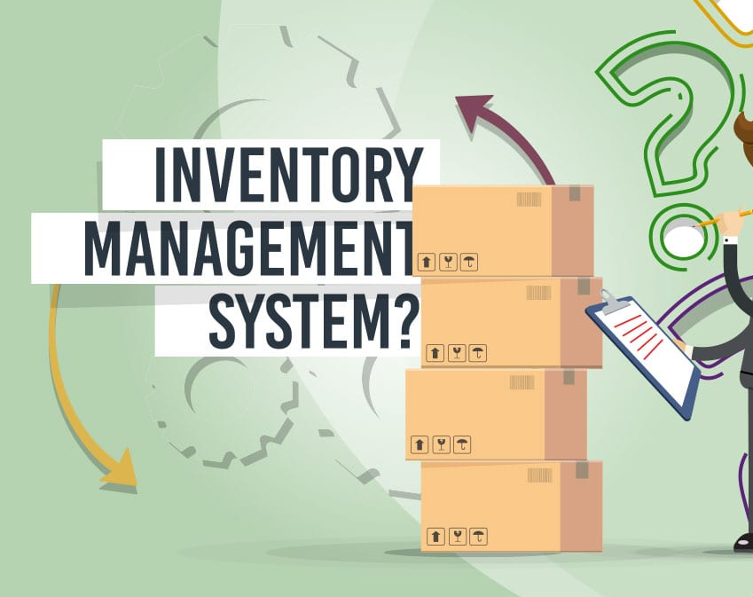
Inventory Management System
BY DEWANSHU KAUSHIK

Slide 2
INTRODUCTION
REQUIREMENT
MODULES

Slide 3
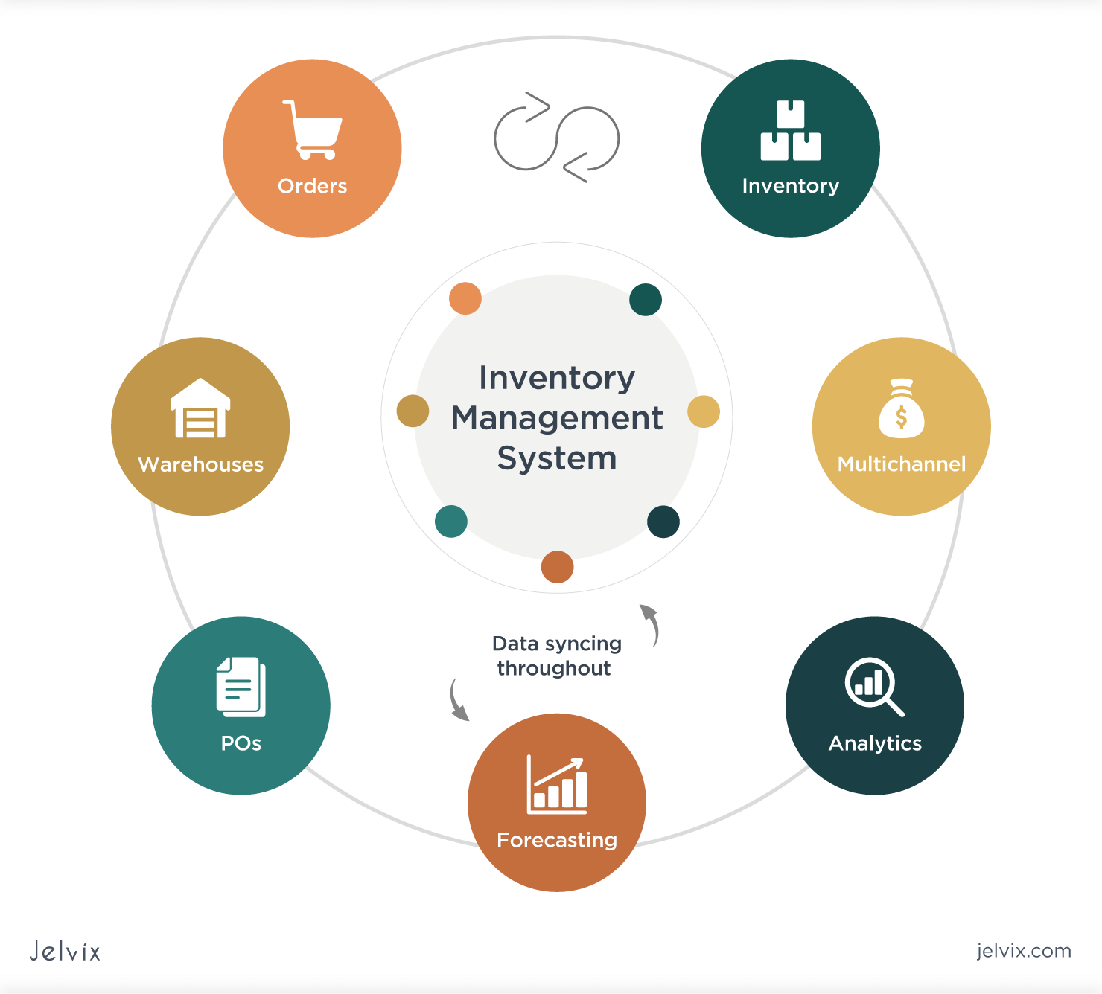

INTRODUCTION

Slide 4

Introduction
An inventory management system is a web-based application that allows businesses to track and manage their inventory levels.
An inventory management system tracks inventory availability at all points of your supply chain from purchasing, to production, and finally sales to consumers.
An inventory management system is important for companies with large amounts of inventory in order to keep it at optimal levels
The system is developed using the Python programming language, HTML for the user interface, CSS for the styling, and MySQL for the database.

Slide 5

Supervisor
Prof. Rabi N. Panda

Slide 6
REQUIREMENT
HARDWARE
SOFTWARE
TECHNOLOGY
TIME

Slide 7

HARDWARE REQUIREMENT
RAM 4GB
PROCESSOR I3

Slide 8
Software Requirement
VSCode
MySQL

Slide 9
TECHNOLOGY
HTML
CSS
PYTHON
MYSQL

Slide 10
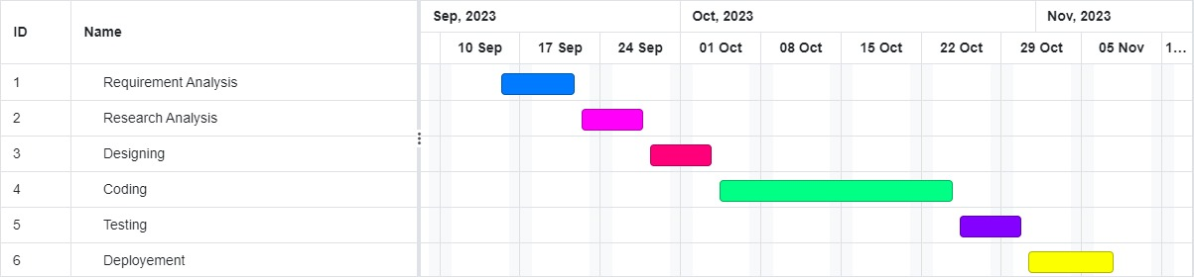
TIME REQUIREMENT

Slide 11
MODULES
ADMIN
SELLER

Slide 12

Admin
Login Page
Admin Panel
Add Category
Add Product
Add User
About

Slide 13

Seller
Seller Panel
Search
Bill Generator

Slide 14
OUTCOME
Track inventory levels
The system should be able to track the quantity of each product in stock in real time.
Generate reports
The system should be able to generate reports on inventory levels, sales, and other key metrics.
Manage orders
The system should allow businesses to create and manage orders. This includes specifying the customer details, the products ordered, and the quantity of each product ordered.

Slide 15

CONCLUSION
The inventory management system developed in Python, MySQL, HTML, and CSS is a valuable tool for businesses. It offers improved inventory control, accuracy, and accountability.
The user-friendly interface and scalability make it a cost-effective solution. Additionally, data analysis and reporting capabilities empower data-driven decision-making, enhancing overall efficiency and profitability.
This system stands as a robust and adaptable asset for businesses seeking to optimize their inventory processes.

Slide 16

REFERENCES
Python:
Python Documentation: https://docs.python.org/
Python Flask Framework: https://pythonbasics.org/what-is-flask-python/)
HTML, CSS, and MySQL:
HTML Tutorial: https://www.w3schools.com/html/
CSS Tutorial: https://www.w3schools.com/css/
MySQL Tutorial: https://www.w3schools.com/MySQL/default.asp
Inventory Management Example:
https://www.forbes.com/advisor/business/software/how-to-manage-inventory/

Slide 17
THANK YOU

